Slide 1

University Of Asia Pacific
Course Name: Database Management Systems Lab
Course Code: CSE 212
Submitted By:
TEAM MEMBER 1 TEAM MEMBER 2
Name: JANNATUL FERDOUS EVA Name: Ayman Hasib
Reg: 18201053 Reg: 18201065
Submitted To:
Molla Rashied Hussein
Designation: Assistant Professor

Slide 2
SEA-LINE HOME LIVING
SEARCH YOUR OWN HOME

Slide 3
Motivation
The Sealine group is one of Bangladesh’s unique investment management organizations: grounded in real estate, powered by people, and growing for the future.
This project which was inspired from the Canadian based real estate company named Skyline.
Our project is almost a part of skyline service, which can provide many living places with basic and luxurious needs. In future, it will be more developed database system by adding superfluous features.
We acquire properties across Bangladesh, and fully manage the properties ourselves, ensuring our residential and commercial tenants are proud to live and work in our buildings. We believe that the communities we serve are the backbone of our success. Our main focus is to attract customers attention and provide maximum service to the customers, so that they can live their lives in a relaxed way.

Slide 4
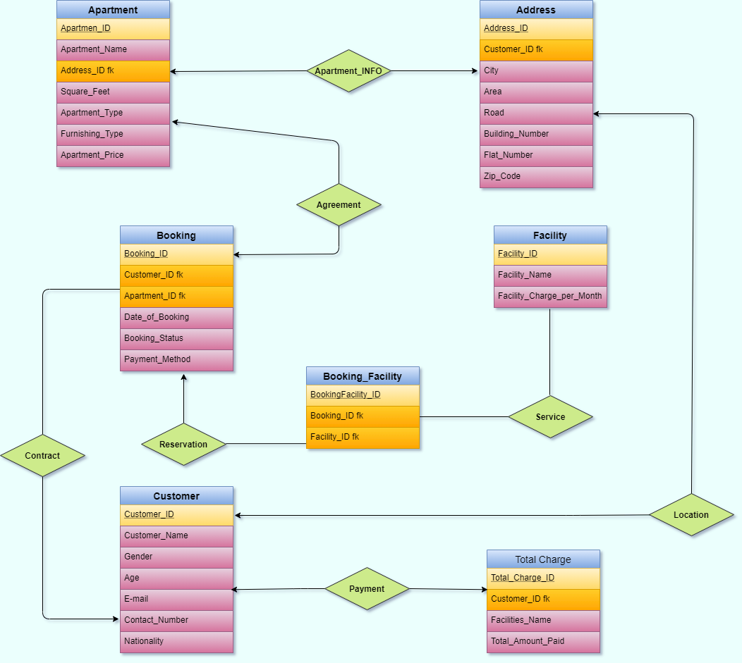
ER Diagram

Slide 5
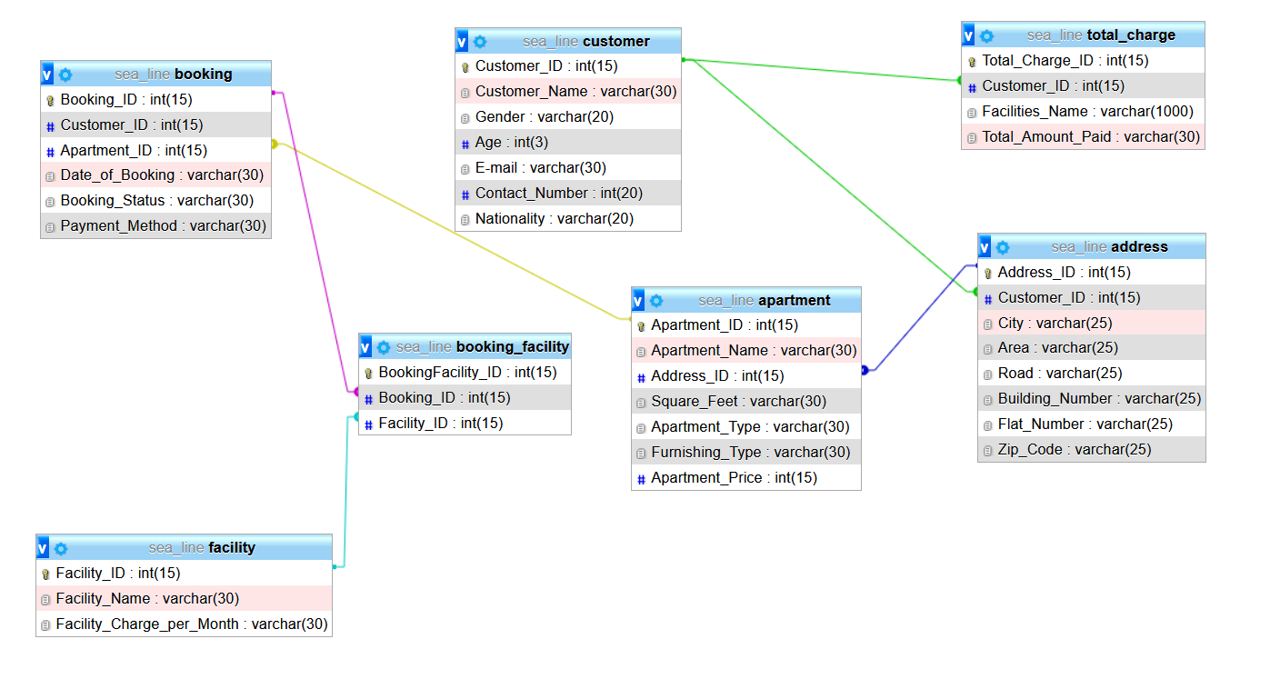
Schema Diagram

Slide 6
Thank You
FEEL FREE TO ASK IF YOU HAVE ANY QUERY

